Slide 1
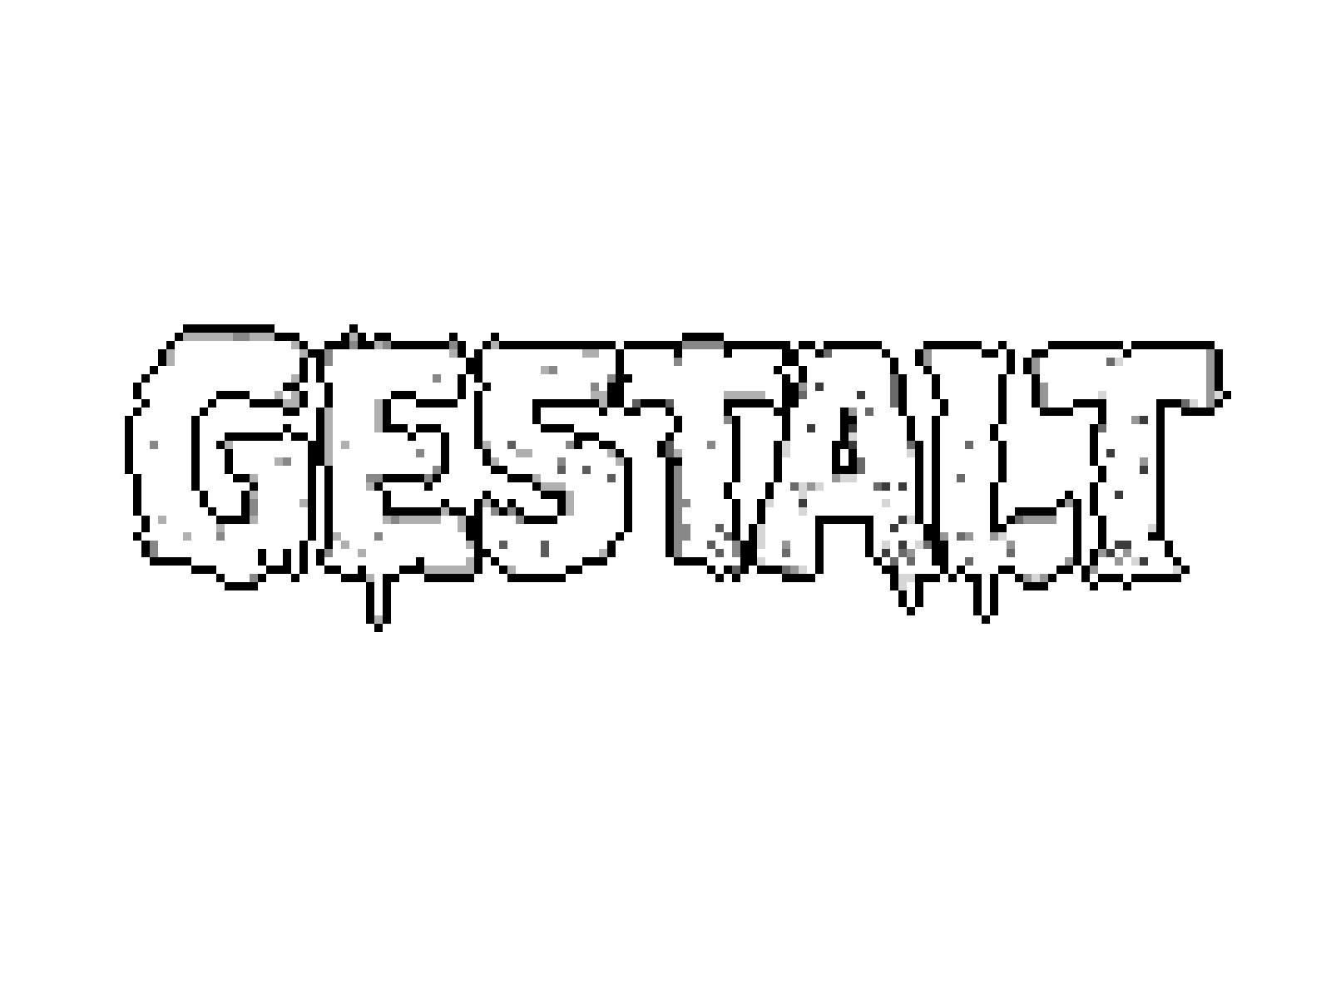
Pitch Document
All work Copyright ©2026
by Kaito Games
Written by Lilly-Jane Nicholls (Noah)

Slide 2
Summary
A turn-based psychological horror game where the protagonist gets trapped inside of a new revolutionary treatment where players can take control of one’s mind and rewrite traumatic events – forcing them to choose between confronting, avoiding, or altering the truth as their past, other patients, and the system itself begin to resist the changes.

Slide 3
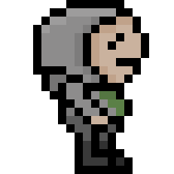
Main Character

Slide 4
HENRY WALSH
The protagonist of the game is a recently resigned police officer who not long lost his wife in a tragic accident. His son was with his wife at the time but survives and is placed in critical condition. Grief and anger builds up in Henry, blaming his son for the whole ordeal and is eventually triggered to kill his son.
After X number of years in prison, Henry is given probation with the expectation to follow a set curfew and attend a new therapy treatment, that is soon to be market launched, as a 'tester'.
Henry at present is an emotionally repressed man who is deeply disconnected from his own reality. He processes trauma through avoidance and rationalization, reframing his past in ways that absolve him from responsibility. He struggles to form genuine connections, viewing others at a distance or through suspicion, yet shows flickers of vulnerability when confronted with reminders of what he has lost.

Slide 5
Setting &
Story
The game is set in a small town called Saltmere; a coastal town in South-West England. A once busy tourist spot that has been slowly left to rot. As to try regain reputation and yield, the local council put their last funds into experimenting on the human mind and learning how to alter memories, alas forming a new 'revolutionary’ treatment to cure trauma patients, specifically targeting those with ptsd and psychological trauma. Saltmere council result to using convicts from the local penile detention centre as testing subjects, which leads our protagonist to the start of his arc. Henry Walsh is geared up and walked through how the simulation works before entering the system, unbeknown to him that the treatment is still heavily unstable and gets sucked into his own mind. With his mind corrupted he must face manifestations of his own guilt, repressed trauma, and fears to escape the system.

Slide 6
In-game content

Slide 7
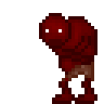
Gameplay & enemies
Gestalt will feature a unique turn-based combat system like Undertale or Fear and Hunger. It will have the standard Fight, Talk, Items and Run options for the player to choose from, but choices made by the player will be reflected in the environment, enemies, and NPCs. It will also feature branching dialogue that will affect the ending that the player receives.
Players will be faced with harder gameplay and slightly differed environments as a way of punishment for running away from enemies or avoiding challenges given to the player; this gives the overall message of avoiding problems only delays the inevitable, often making them worse.
Alongside this when players choose the action 'run’ they will be given a 50/50 chance of either successfully running away or failing and losing half health and having to fight anyway.

Slide 8
Why steam for Platform choice?
147M
75%
5,800
Monthly active users
Distribution control
Indie games earnt >100,000
Major visibility potential.
Constant active audience.
Better chance of whishlists and reviews.
Most pc players already use steam.
Players trust steam storefront and payment system.
Indie games make up around 40% units sold.
Steam actively pushes;
Discovery queue, wishlist notifications, similar games

Slide 9
Goals FOR THE GAME
GOAL 1:
GOAL 2:
GOAL 3:
To use the environments to communicate clear narrative and emotional context. Players should feel immersed into the story and be able to connect with the protagonist through exploring and interacting with their surroundings.
To create a lucid and recognizable tone and thematic direction that differentiates the project within the psychological horror space.
For players to feel a constant sense of unease and uncanniness, even during quiet moments. And to not know whether their actions are helping or causing harm.

Slide 10
THANK YOU
Lilly-Jane Nicholls (Noah)​
nbnicholls27@gmail.com Narrative Designer
Alfie.newbon@gmail.com Project Lead & Game Designer

